Slide 1
ELECTRON SPIN RESONANCE
Kondrachuk Yaroslav

Slide 2
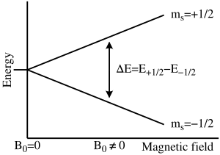
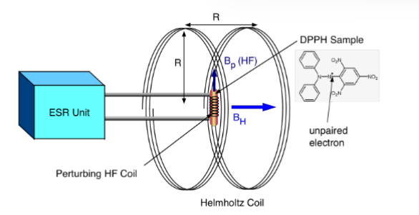

Objective:
In this experiment, we investigate the phenomenon ELECTRON SPIN RESONANCE.
This effect is described by equation
$$∆E=hf=g_{s}μ_{B}\left(B_{mod}+B_{0}\right)$$
where μ_{B} is Bohr magneton, g_{s} is a constant, which is designated as the g-factor for the spin of the electron and which we want to find for the given sample.
B₀ is the homogeneous magnetic field in the Helmholtz coils is calculated using Biot-Savart's law:
$$B_{0}=μ_{0}{(\frac{4}{5})}^{\frac{3}{2}}\frac{n}{R}I$$
And B_{mod} is HF coil hich is a part of a high-duty oscillating circuit.

Slide 3
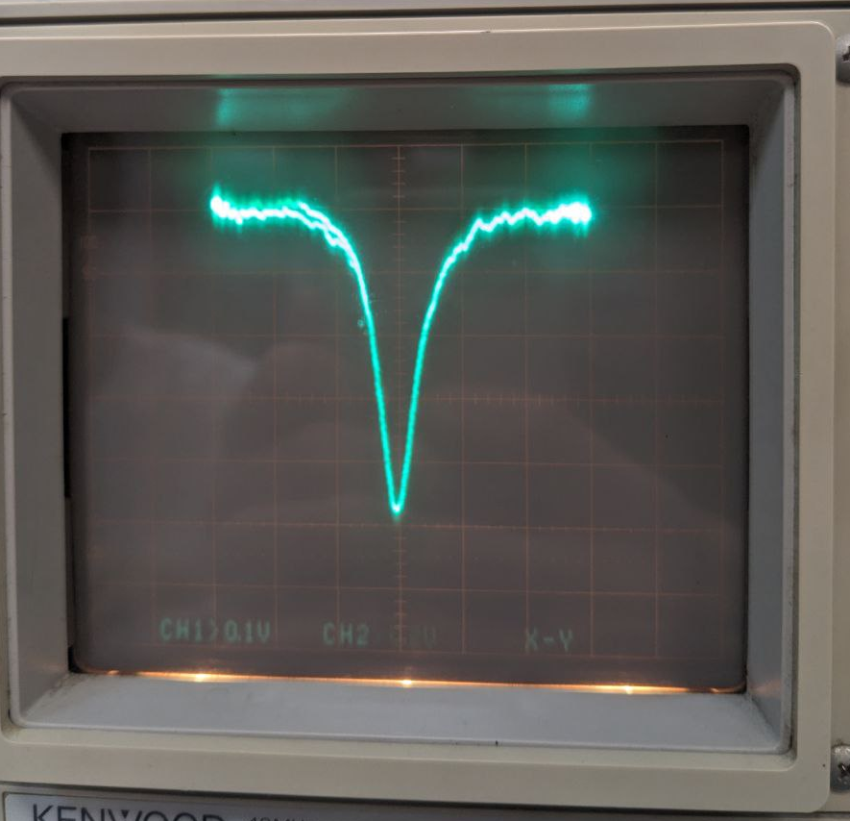
Results
For different value of frequency of B_{mod} and measure the value of DC current to get the image of resonance.

Slide 4

Summary
The model curves in Figure 1 were
calculated with $k=\left(0.0090±0.0002\right)∗{10}^{−9}$as fitting parameter.
Where $k=\frac{h}{g_{s}μ_{B}}→g_{s}=\frac{h}{μ_{B}∗k}=\frac{6.62e−34}{9.24E−24∗0.009∗{10}^{−9}}=(7.93±0.18)$

